Slide 1
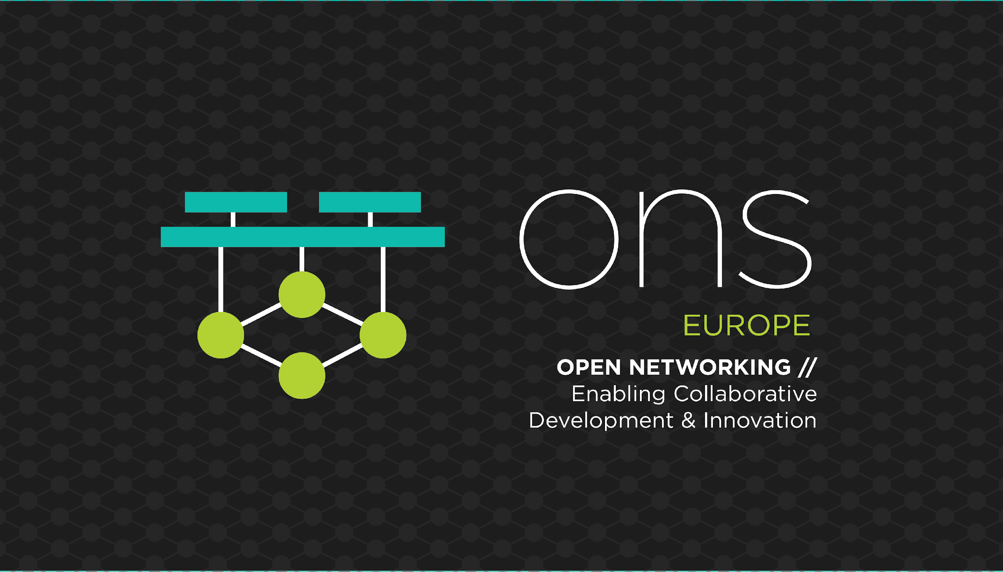

Slide 2
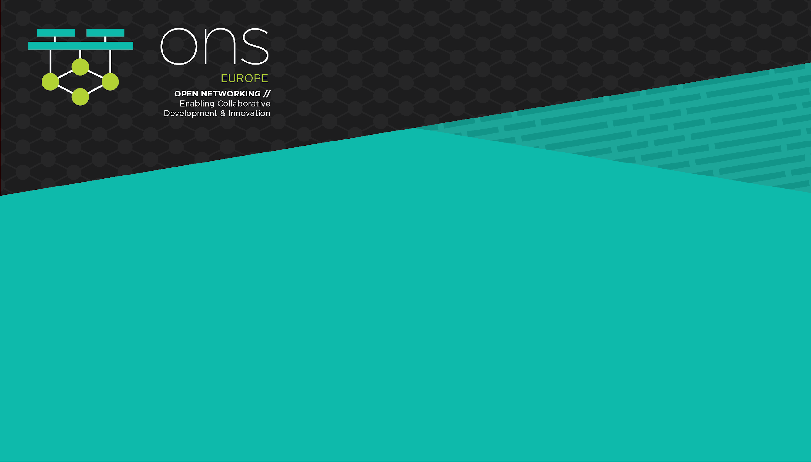
Large-scale Network Simulations in Kubernetes

Slide 3
$ whoami - Michael Kashin
Network Engineer/Architect/Developer @Arista Networks
Github: @networkop
Twitter: @networkop1
Blog: networkop.co.uk
Notes:
First, a few words about myself. My name is Michael Kashin and I’m an advanced service engineer @ arista networks, however I feel like network engineer/architect/developer title is a more accurate description of my current role and responsibilities. I do everything ranging from traditional network designs to what people call NetDevOps and software development and this presentation about the latter. However the former (network engineering) role is very important for me as it helps me stay close to the real problems and often serves as a source of inspiration for my NetDevOps activities.
I’ve got a standard set of social media accounts, if you want to connect, and I’ve got a blog where I write about my various findings and experiments. So if you’re interested in things like network automation and SDN, you’re welcome to check it out.

Slide 4
Problem Statement

Slide 5
Why simulating physical network?
Studying/Labbing
Network design validation
Continuous Testing pipelines
Notes:
There are 3 main use cases for physical network simulation
Studying and labbing - this is a relatively simple use-case that has been around for more than a decade. Characterised by small-scale short-lived labs, usually with a graphical user interface.
Design validation may require a bigger scale, especially if the network to be validated is large and/or contains many corner-case scenarios a.k.a snowflakes.
CI/CD pipelines require completely automated simulations - building and configuring virtual networks without any user interaction, but based on user-provided input (e.g. text file)

Slide 6
Lay of the land
Multiple commercial and open-source products exist:
GNS3
EVE-NG
vrnetlab
Most of them are single-node-only deployments
Work well for studying/labbing
Vendor’s virtual devices are huge VMs (~10GB+2vCPU)
Notes:
Currently there are a number of commercial and open-source products exist that can be used for network simulations. These solutions only target single-node deployments which works well for labbing and studying but limits the size of network that can be simulated. Given the size and requirements of some virtual devices, it’s easy to imaging how we can quickly hit the upper limit, even on the beefiest of servers and labbing of a full-scale production network quickly becomes an exercise in compromise and trade-offs.

Slide 7
Kubernetes as a network simulation platform
Compute resources are cheap and abundant
Kubernetes is the pervasive “cloud-native operating system”
but
Kubernetes IP-per-pod networking model is restrictive
Existing CNI plugins address the NFV use-cases
Somewhere there are still bridges
Notes:
At the same time compute resources are cheap and abundant on any public cloud, treating multiple hosts as a single pool of resources. In order to spin up multiple virtual network devices on different hosts, we need a system that can do (CPU/RAM) resource tracking and reservation, mapping of each network device to a particular host (a.k.a. scheduling) and lifecycle management, i.e. health monitoring, restarting of the failed devices etc. Multiple systems can meet these criteria so the choice of Kubernetes (K8s) is mostly random in this case. One benefit the K8s brings is its pervasiveness in modern public and private clouds, as it’s becoming the “cloud-native operating system”.
However the K8s cluster networking model is somewhat restrictive and doesn’t provide an easy way to run network simulations on top of it. Multiple solutions exist that try to address some of these limitations, mostly targeted at running NFV-based applications on top of K8s - they either require some form of interaction with the underlay (macvlan, calico, kuberouter) or only provide L3 connetivity between pods (flannel, ovn, calico). And ultimately there is always a bridge somewhere (linux bridge, OVS, VPP), which can create issues for L2 traffic like LLDP, LACP, STP.

Slide 8
meshnet

Slide 9
Main goals
Connect arbitrary number links inside a pod
veth - if pods are on the same node
vxlan - if pods are on different nodes
macvlan - to connect to the underlay
All links will be point-to-point, without any bridges (thanks koko)
Non-disruptive to other Kubernetes resources
Asynchronous operation
Notes:
So I’ve decided to write my own CNI plugin with the following goals in mind. The primary goal of meshnet plugin is to interconnect pods via direct point-to-point links according to some user-defined topology. To do that, the plugin uses three types of links:
veth - used to connect two pods running on the same host
vxlan - used to connected two pods running on different hosts
macvlan - used to connect to external resources, i.e. any physical or virtual device outside of the Kubernetes cluster
All links must be bridgeless, meaning completely transparent to L2 traffic
Meshnet must coexist with other kubernetes resources and should not require any extra effort to manage them - deploy, delete standard manifests

Slide 10
How to build a custom CNI plugin
Talks, blogs and existing examples:
Kubernetes and CNI - Kubecon 2018
Writing a CNI plugin with Bash
EVPN CNI plugin
Workflow for writing CNI plugins
Flannel, Weave, AWS CNI
CNI specification
CNI standard plugins
Notes:
Building your own CNI plugin is not as scary as it may seem, especially if you have a very specific use-case. There are a few very good talks and write-ups about how to approach this problem and what to look out for. But

Slide 11
CNI plugin ADD call
CNI_COMMAND=ADD \
CNI_CONTAINERID=$id \
CNI_NETNS=/proc/$pid/ns/net \
CNI_ARGS=K8S_POD_NAMESPACE=$ns;K8S_POD_NAME=$name
/opt/cni/bin/my-plugin < /etc/cni/net.d/my-config
Notes:
At a very high level, every CNI plugin is just a binary and a configuration file installed on K8s worker nodes. When a pod is scheduled to run on a particular node, a local node agent (kubelet) calls a CNI binary and passes all the necessary information to it. That CNI binary connects and configures network interfaces and returns the result back to kubelet. The information is passed to CNI binary in two ways - through environment variables and CNI configuration file.

Slide 12
Choosing a backend
Backend is used to synchronise runtime state:
Namespaces
Nodes where pods are deployed
Read the topology data
etcd seems like an obvious choice but external etcd cluster requires an operator
CRDs require RBAC and user credentials
Notes:
However, since i’m connecting p2p links between different pods, I need to store some runtime information about a pod, that will be used by other pods to connect those links. For example, 2 pods on the same node will need to know each other’s namespace in order to know where to plug different sides of the veth link. If pods are on different nodes, we also need to know the IP of the peer pod in order to setup a vxlan link.
ETCD seems like an obvious choice, after all it’s used by the kubernetes control plane. The two common approaches here are:
To use an external etcd cluster, running on top of k8s. this way we don’t interfere with the k8s control plane. and some of the earlier versions of flannel and cilium used this approach, which means that you need to deploy an etcd operator to manage the lifecycle of etcd
The second approach is to store data inside k8s’s etcd cluster as custom resources. Both flannel and cilium (along with a wide range of CNI plugins) are using it now. However the problem here is that cni plugin now needs to talk to k8s API, which means it has to authenticate somehow. Generating and distributing and managing keys means extra operational overhead, which is bad. So how to avoid it?

Slide 13
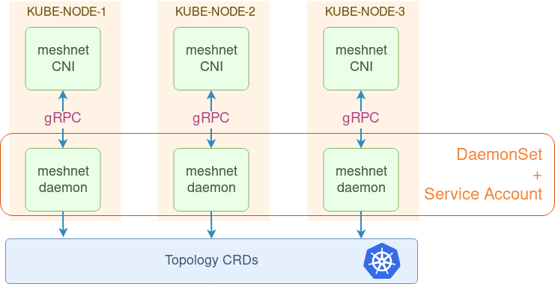
Notes:
meshnet is deployed as daemonset - the CNI plugin is written into a special “hostpath” volume, making it visible in the host OS’s filesystem, and available to kubelet. Meshnet daemon runs inside a container with a special service account, with access to k8s API.

Slide 14
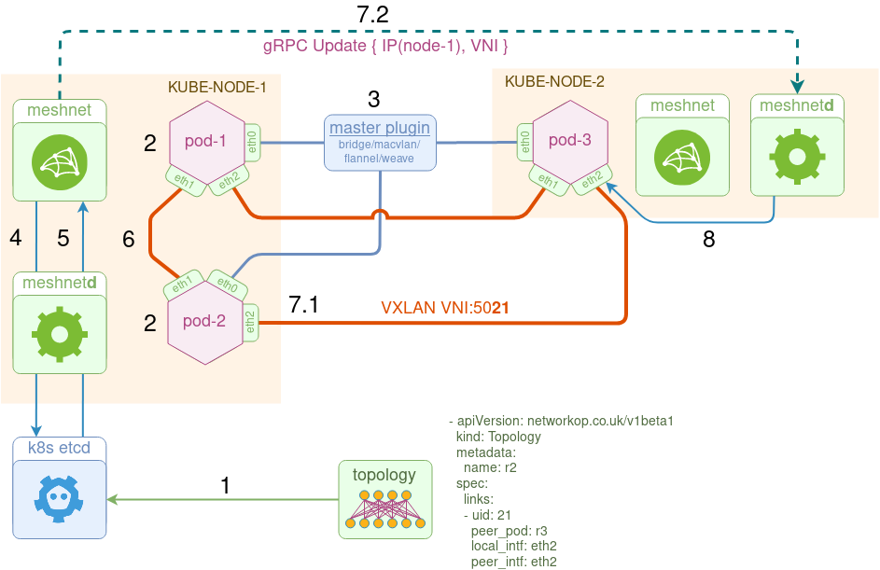
Notes:
Below is the order of operation of the plugin from the perspective of kube-node-1:
1 Kubernetes cluster gets populated with the topology information via custom resources
2 pod-1/pod-2 come up, local kubelet calls the meshnet binary for each pod to setup their networking.
3 meshnet binary delegates the ADD command to the "master" plugin specified in the CNI configuration file, which connectes interface eth0. eth0 is always setup by one of the existing CNI plugins. It is used to provide external connectivity to and from the pod
4 meshnet binary updates the topology data with pod's runtime metadata (namespace filepath and primary IP address).
5 meshnet binary (via a local meshnet daemon) retrieves the list of links and looks up peer pod's metadata to identify what kind of link to setup - veth, vxlan or macvlan.
6 If the peer is on the same node, it calls koko to setup a veth link between the two pods.
7 If the peer is on the remote node, it does two things:
7.1 It calls koko to setup a local vxlan link.
7.2 It makes a gRPC Update call to the remote node's meshnet daemon, specifying this link's metadata (e.g. VTEP IP and VNI).
8 Upon receipt of this information, remote node's meshnetd idepmotently updates the local vxlan link, i.e. it creates a new link, updates the existing link if there's a change or does nothing if the link attributes are the same.

Slide 15
2-node topology CRDs
- apiVersion: networkop.co.uk/v1beta1
kind: Topology
metadata:
name: r1
spec:
links:
- uid: 1
peer_pod: r2
local_intf: eth1
local_ip: 169.254.0.1/24
peer_intf: eth1
peer_ip: 169.254.0.2/24
- apiVersion: networkop.co.uk/v1beta1
kind: Topology
metadata:
name: r2
spec:
links:
- uid: 1
peer_pod: r1
local_intf: eth1
local_ip: 159.254.0.2/24
peer_intf: eth1
peer_ip: 169.254.0.1/24

Slide 16
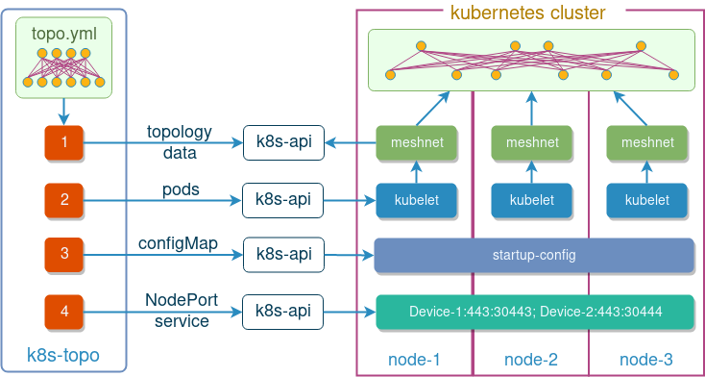
k8s-topo - topology orchestrator

Slide 17
k8s-topo 2-node topology definition
---
links:
- endpoints: ["sw-1:eth1:169.254.0.1", "sw-2:eth1:169.254.0.2"]

Slide 18
End-to-end workflow
Start with a working Kubernetes cluster
Install meshnet-cni plugin
Install k8s-topo as a deployment
Create the topology definition YAML file
(Optional) Create startup configurations
Instantiate the topology

Slide 19
Demo

